Slide 1
Statistical Computing Methods for Data Science
Unit- I, Lecture 1
By
S U Ravi Kumar Ch
Assistant professor of Mathematics
Department of Science and Humanities
Sreenidhi Institute of Science and Technology
Yamnampet, Ghatkesar.
1

Slide 2
Methods for Data Science
Mathematical Methods
  Certainty in data
Statistical Methods
  Uncertainty in data

Slide 3
Prerequisites
Basics of Probability and statistics

Slide 4
Representation of Data
Frequency Distributions
Frequency Distribution Tables
Frequency Graphs

Slide 5
Frequency Distributions
After collecting data, the first task for a researcher is to organize and simplify the data so that it is possible to get a general overview of the results.
This is the goal of descriptive statistical techniques.
One method for simplifying and organizing data is to construct a frequency distribution Table.

Slide 6
Frequency Distributions (cont.)
A frequency distribution is an organized tabulation showing exactly how many individuals are located in each category on the scale of measurement. A frequency distribution presents an organized picture of the entire set of scores, and it shows where each individual is located relative to others in the distribution.

Slide 7
Frequency Distribution Tables
A frequency distribution table consists of at least two columns - one listing categories on the scale of measurement (X) and another for frequency (f).
In the X column, values are listed in the form of ascending or descending order, without skipping any values.
For the frequency column, tallies are determined for each value (how often each X value occurs in the data set). These tallies are the frequencies for each X value.
The sum of the frequencies is denoted by N.

Slide 8
Regular Frequency Distribution
When a frequency distribution table lists all of the individual categories (X values) it is called a regular frequency distribution.

Slide 9
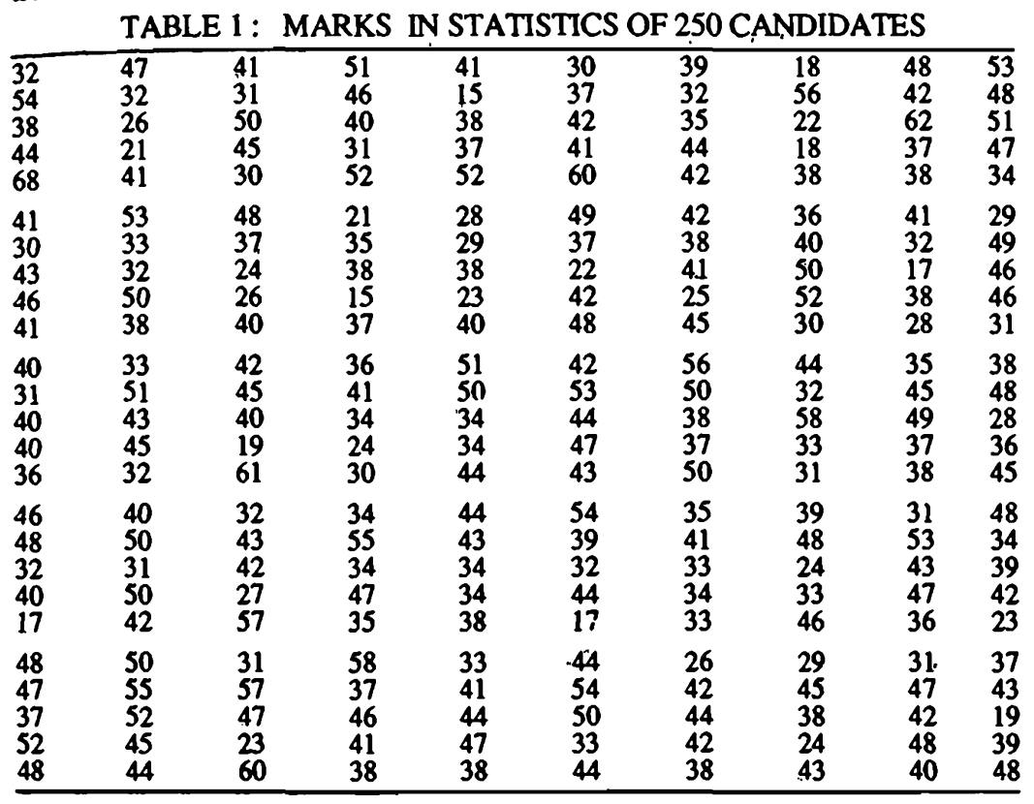


Slide 10
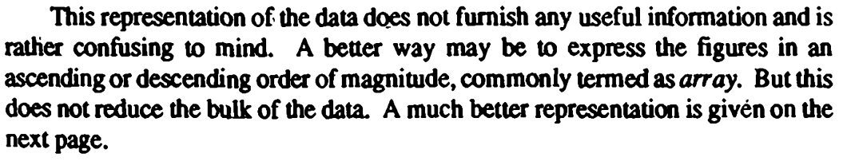

Slide 11
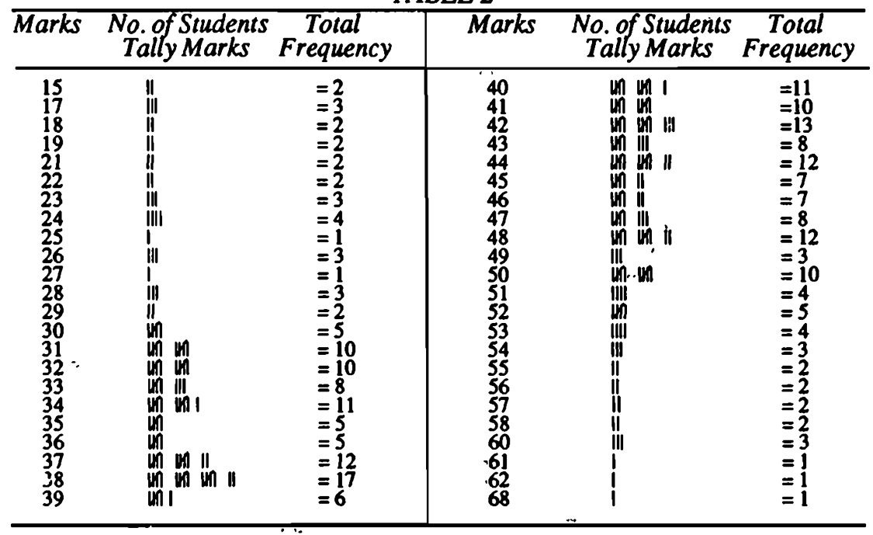

Slide 12
Grouped Frequency Distribution
Sometimes, however, a set of scores covers a wide range of values. In these situations, a list of all the X values would be quite long - too long to be a “simple” presentation of the data.
To remedy this situation, a grouped frequency distribution table is used.

Slide 13
Grouped Frequency Distribution (cont.)
In a grouped table, the X column lists groups of scores, called class intervals, rather than individual values.
These intervals all have the same width, usually a simple number such as 2, 5, 10, and so on.

Slide 14
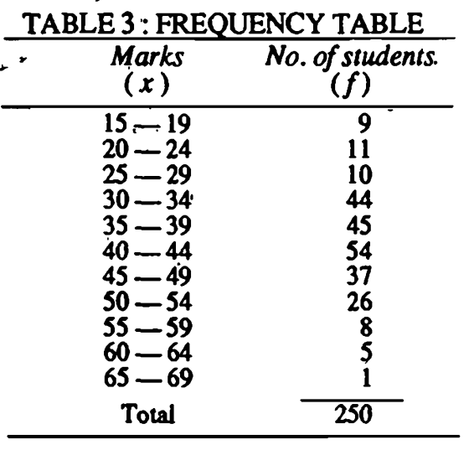

Slide 15
Points for classification
The classes should be clearly defined.
Should be exhaustive.
Must be mutually exclusive.
Each interval begins with a value that is a multiple of the interval width.
The interval width is selected so that the table will have approximately 5 to 15 intervals.
Approximate number of classes is
  k=1+(3.322) log₁₀ N
  Where N is the total frequency

Slide 16
Frequency Distribution Graphs
In a frequency distribution graph, the score categories (X values) are listed on the X axis and the frequencies are listed on the Y axis.
When the score categories consist of numerical scores from an interval or ratio scale, the graph should be either a histogram or a polygon.

Slide 17
Histograms
In a histogram, a bar is centered above each score (or class interval) so that the height of the bar corresponds to the frequency and the width extends to the real limits, so that adjacent bars touch.

Slide 18
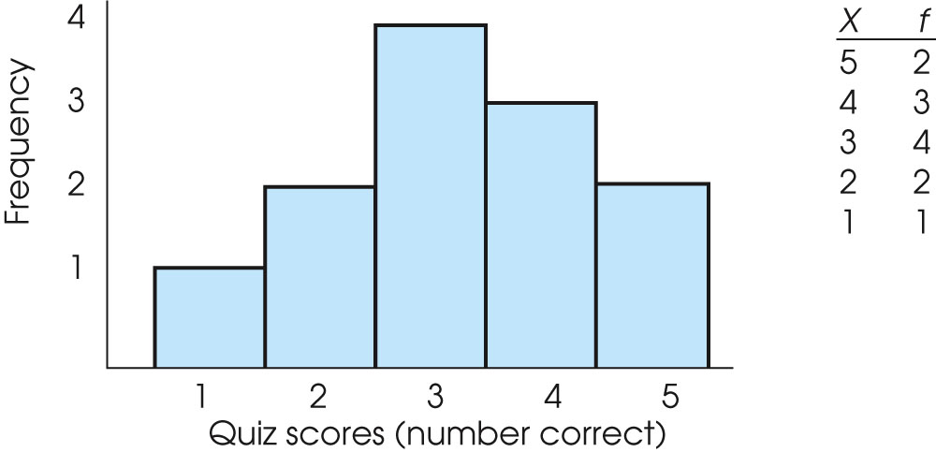
Example of Histogram for scores

Slide 19
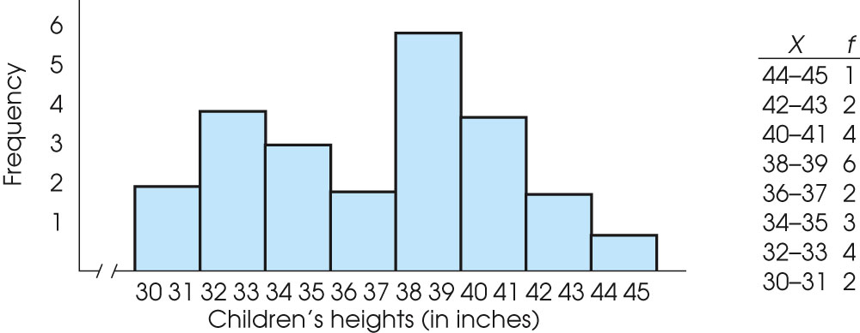
Example of Histogram for class intervals
Notes:
Figure 2.2
An example of a frequency distribution histogram. The same set of quiz scores is presented in a frequency distribution table and in a histogram.
Figure 2.3
An example of a frequency distribution histogram for grouped data. The same set of children’s heights is presented in a frequency distribution table and in a histogram.

Slide 20
Polygons
In a polygon, a dot is centered above each score so that the height of the dot corresponds to the frequency. The dots are then connected by straight lines. An additional line is drawn at each end to bring the graph back to a zero frequency.

Slide 21
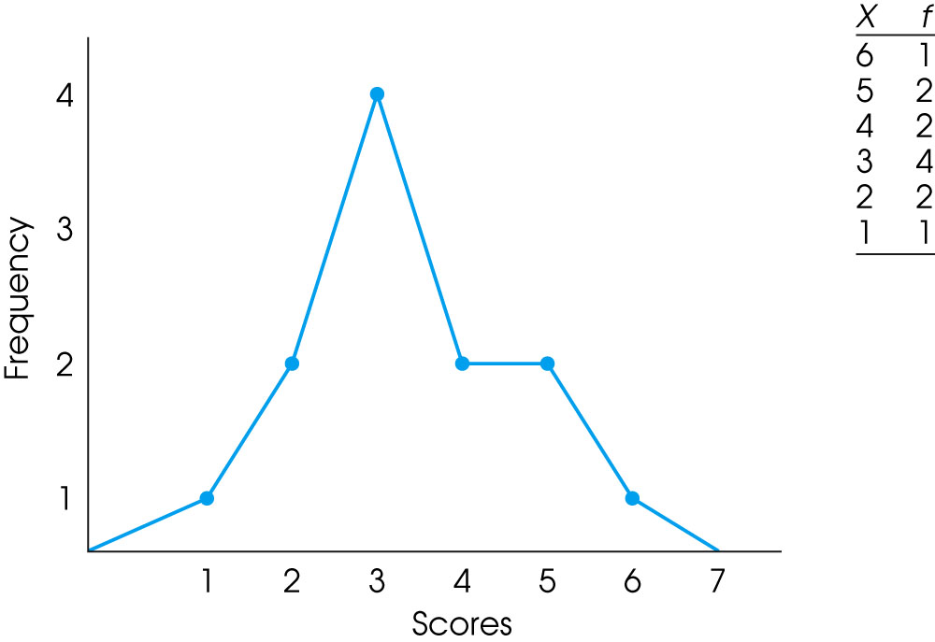
Polygon for scores

Slide 22
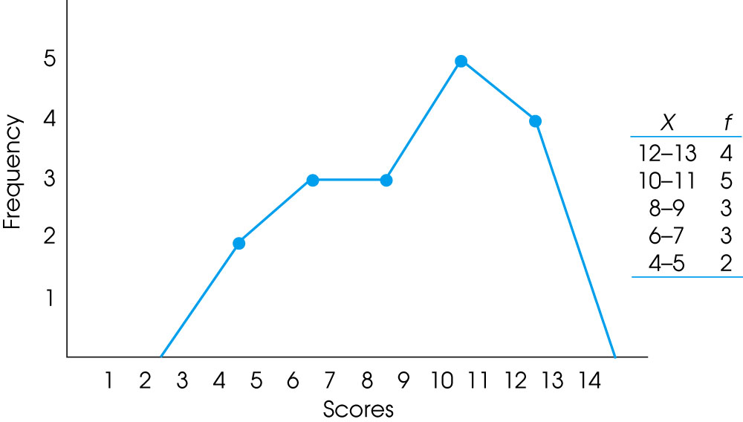
Polygon for class intervals
Notes:
Figure 2.5
An example of a frequency distribution polygon. The same set of data is presented in a frequency distribution table and in a polygon.
Figure 2.6
An example of a frequency distribution polygon for grouped data. The same set of data is presented in a grouped frequency distribution table and in a polygon.

Slide 23
Relative frequency
Many populations are so large that it is impossible to know the exact number of individuals (frequency) for any specific category.
In these situations, population distributions can be shown using relative frequency instead of the absolute number of individuals for each category.

Slide 24
Classification of Data
The first step in summarizing quantitative data is to determine whether the data is discrete or continuous.
If the data is discrete, the categories of data will be the observations (as in qualitative data),
If the data is continuous, the categories of data (called classes) must be created using intervals of numbers.
Notes:
Tatal

Slide 25
(i) Discrete Data
EXAMPLE:1
Constructing Frequency and Relative Frequency Distribution from Discrete Data

Slide 26
EXAMPLE1( cont’)
The following data represent the number of available cars in a household based on a random sample of 50 households. Construct a frequency and relative frequency distribution.
3 0 1 2 1 1 1 2 0 2
4 2 2 2 1 2 2 0 2 4
1 1 3 2 4 1 2 1 2 2
3 3 2 1 2 2 0 3 2 2
2 3 2 1 2 2 1 1 3 5
Data based on results reported by the United States Bureau of the Census.
Notes:
Tatal

Slide 27
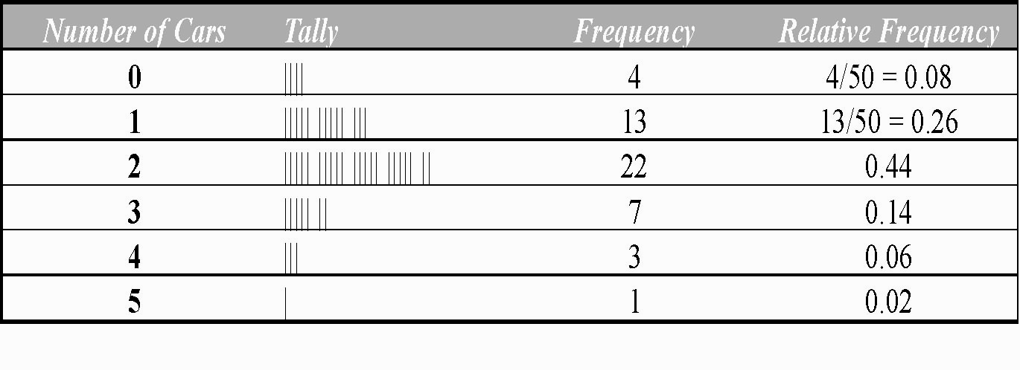
EXAMPLE 1 (cont’)
Frequency and Relative Frequency Table
Notes:
Tatal

Slide 28
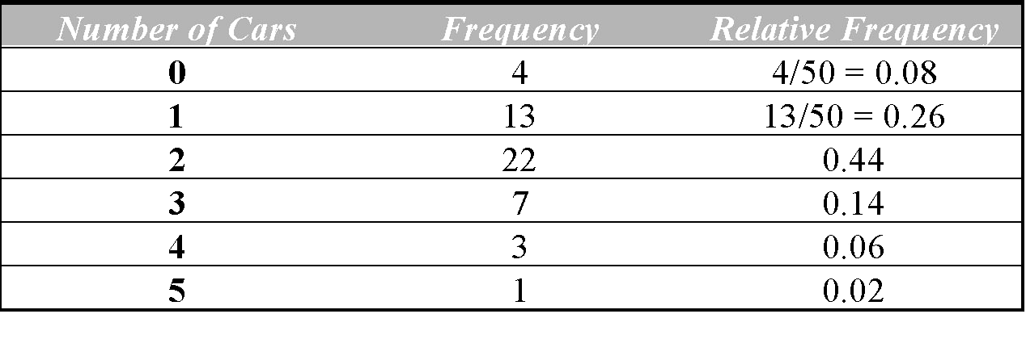
EXAMPLE 2 Drawing a Histogram for Discrete Data
Draw a frequency and relative frequency histogram for the “number of cars per household” data.
Notes:
Tatal

Slide 29
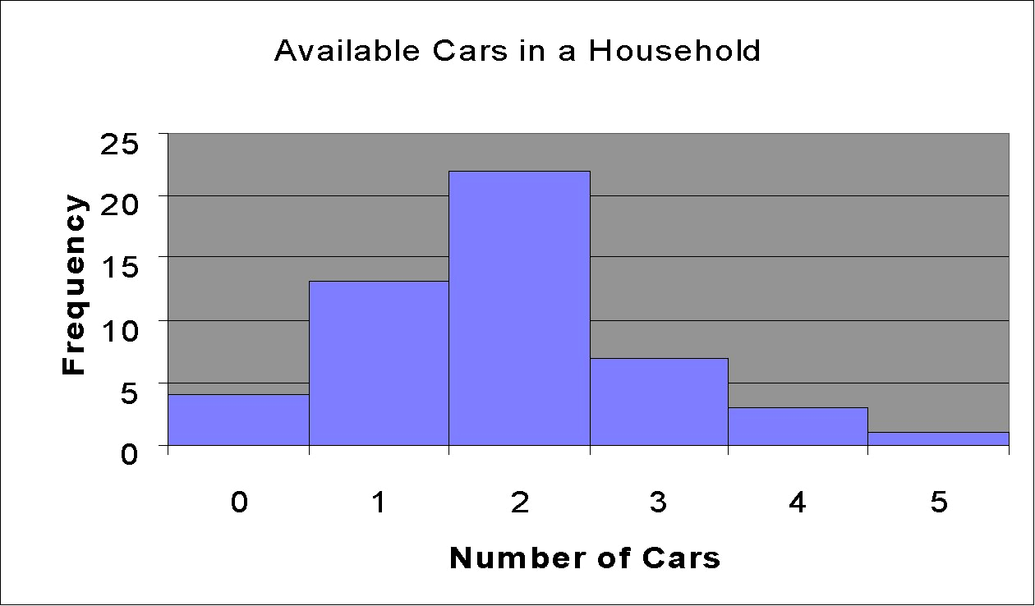
Notes:
Tatal

Slide 30
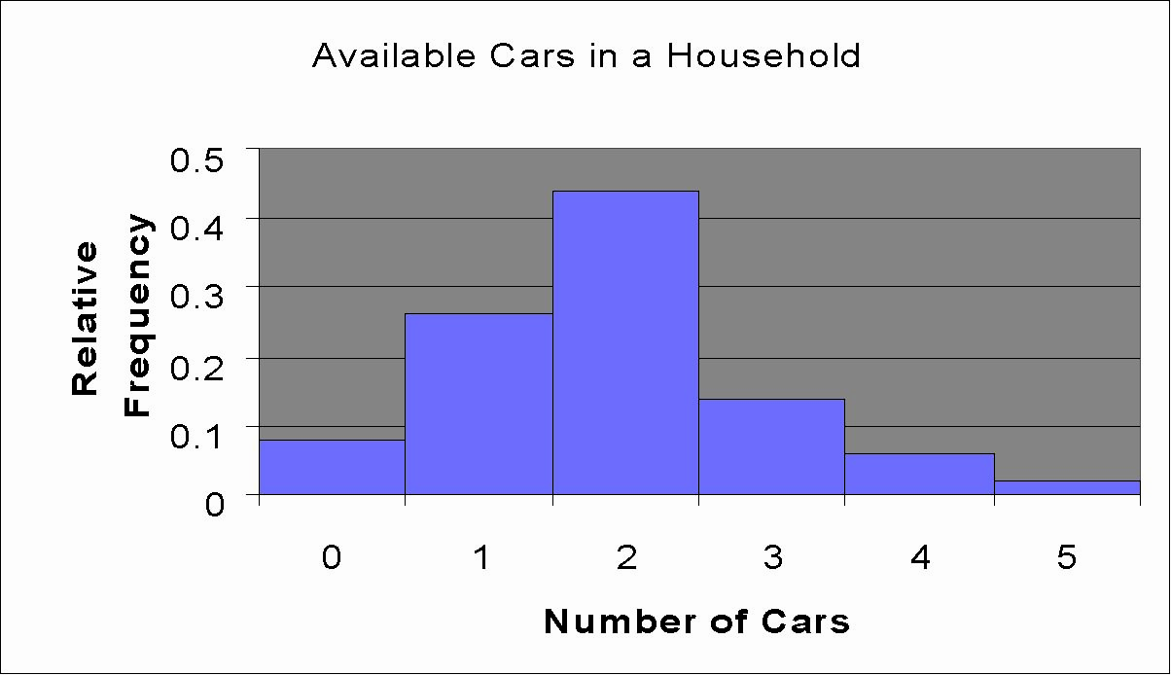
Notes:
Tatal

Slide 31
(II) Continuous Data
Categories of data are created for continuous data using intervals of numbers called classes.
Notes:
Tatal

Slide 32
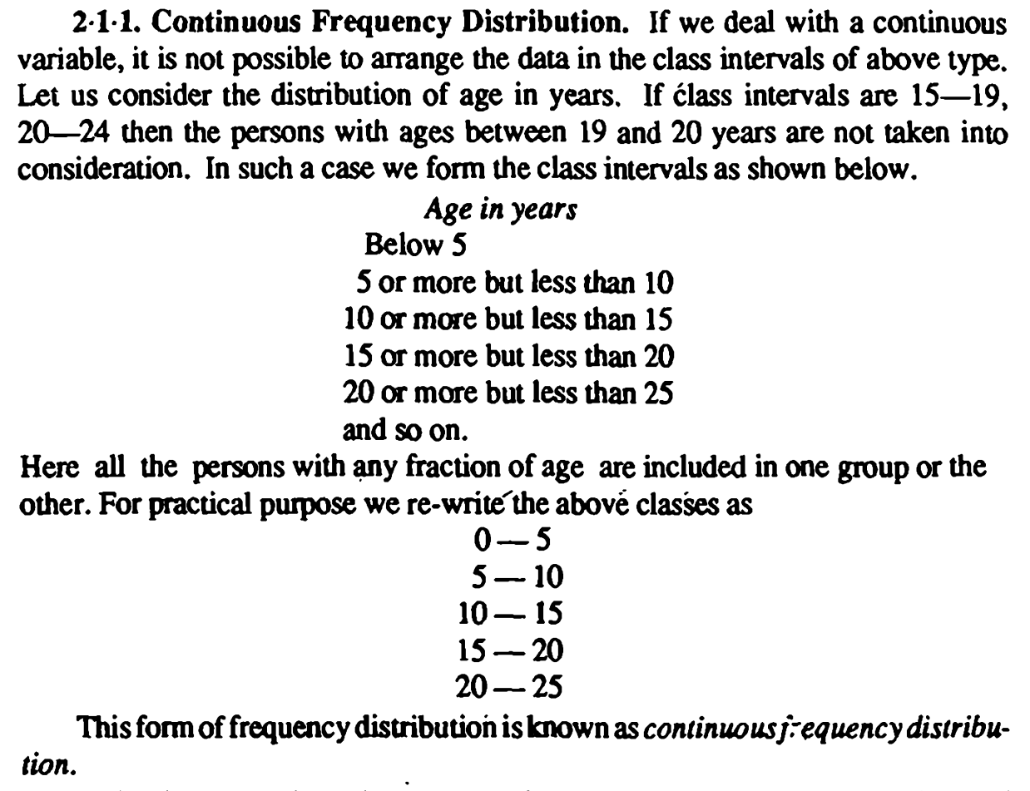

Slide 33
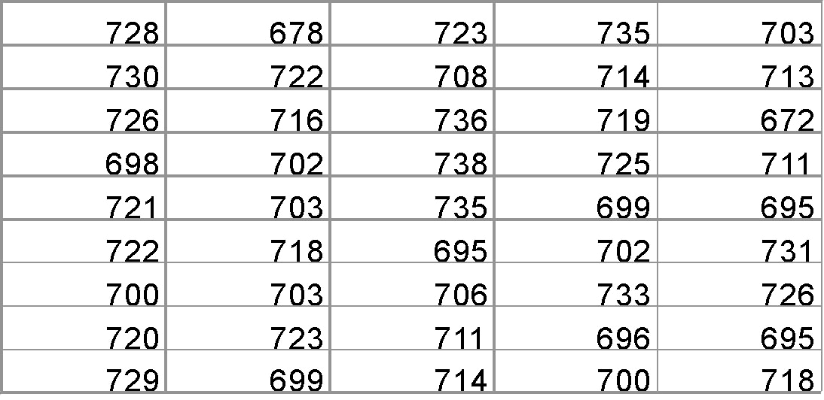
EXAMPLE 2:
Organize Data into a Frequency and Relative Frequency Distribution and draw the frequency histogram
The following data represent the time between eruptions (in seconds) for a random sample of 45 eruptions at the Old Faithful Geyser in California. Construct a frequency and relative frequency distribution of the data.
Source: Ladonna Hansen, Park Curator
Notes:
Tatal

Slide 34
The smallest data value is 672 and the largest data value is 738. We will create the classes so that the lower class limit of the first class is 670 and the class width is 10 and obtain the following classes:
670 - 679
680 - 689
690 - 699
700 - 709
710 - 719
720 - 729
730 - 739
Notes:
Tatal

Slide 35
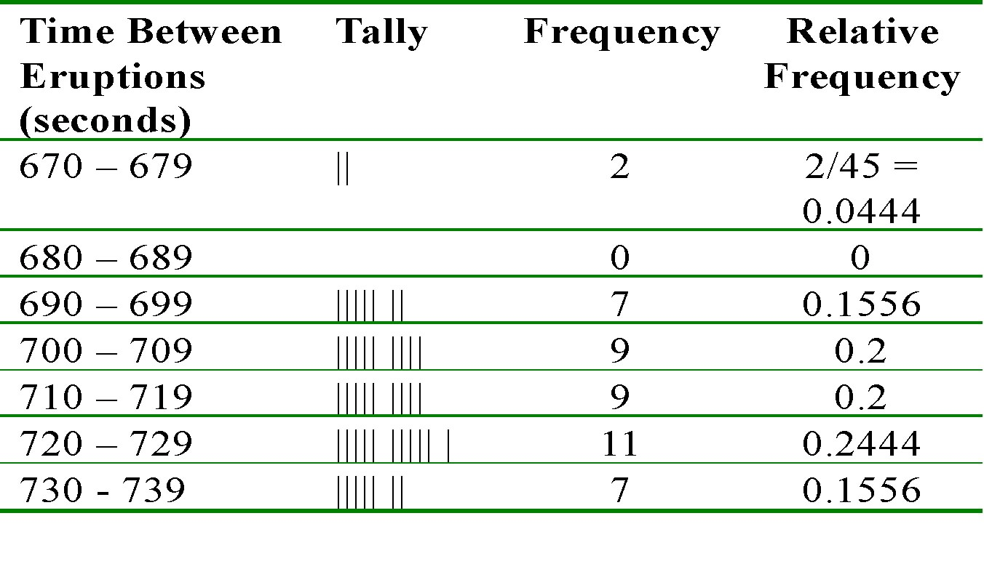
Frequency Table Using class width of 10
Notes:
Tatal

Slide 36
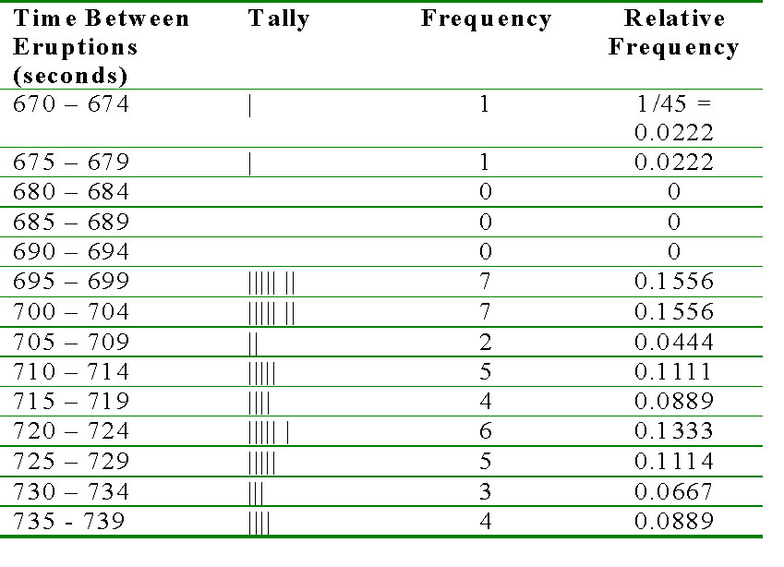
Frequency Table Using class width of 5
Notes:
Tatal

Slide 37
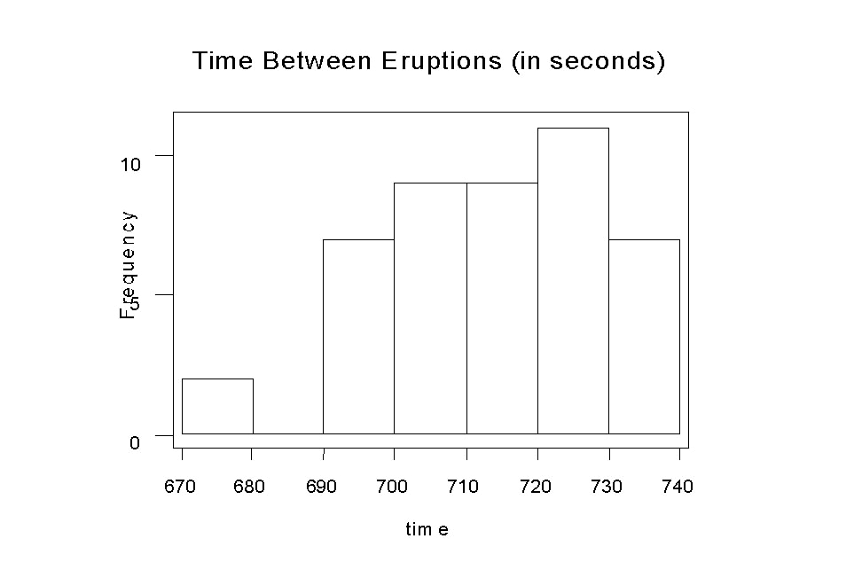
EXAMPLE Constructing a Frequency and Relative Frequency Histogram for Continuous Data
Using class width of 10: Frequency Histogram
Notes:
Tatal

Slide 38
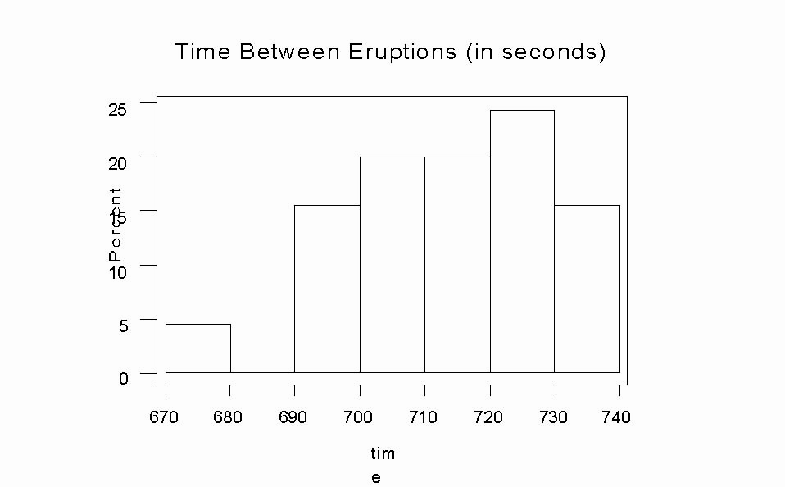
Using class width of 10: Relative Frequency Histogram
Notes:
Tatal

Slide 39
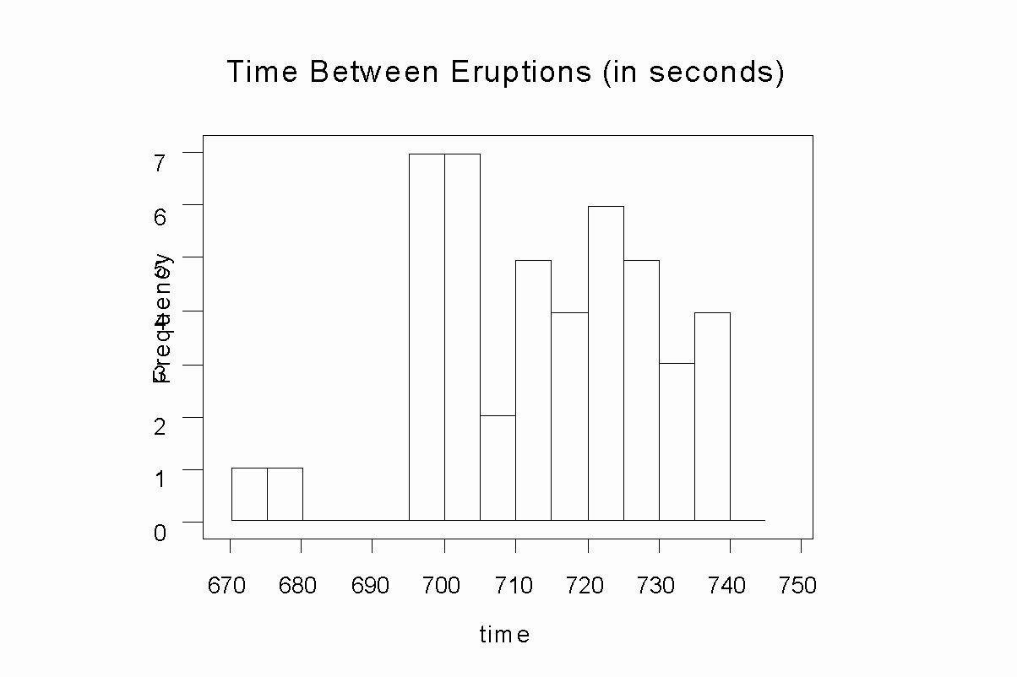
Using class width of 5: Frequency Histogram
Notes:
Tatal

Slide 40
THANK YOU
Feed Back to
ravikumarch@sreenidhi.edu.in

